Slide 1
Mean Green Growing Machine
Weekly Meeting 4 Blocker

Slide 2
9/17/20
John Berger
Accomplished this week: WBS 60% filled IMS 90% filled IMP - Complete Talked to Eli about ECE Integration | Potential pitfalls Holy cow this is allot of documentation
To be accomplished in next 2 weeks: Write PMP (DUE TOMORROW) Create PMP Slides (DUE Sunday) Create SRD Kickoff research phase | Help needed Filling remaining WBS descriptions Review IMP/IMS for agreement Review Part # structure

Slide 3
9/17/20
Max Merritt
Accomplished this week: Team Charter 70% complete Budget form (no real items on budget) Team Org Chart | Potential pitfalls ECE team is blocked by Dohr
To be accomplished in next 2 weeks: Finalize Team Org chart Choosing systems/ leads | Help needed Finishing team charter Approve or improve budget form
General Ideas: Who are some people we can use as people-resources?

Slide 4
9/17/20
Thuya Sathiamurthi
Accomplished this week: Statement of work Procurement sheet | Potential pitfalls English skills
To be accomplished in next 2 weeks: Start research and design | Help needed

Slide 5
9/17/20
Conor Vasiliadis
Accomplished this week: Risk Categorizing and Listing Set legend for occurrence and severity | Potential pitfalls Unknown Risks(feel free to add idea and I will fill in the rest)
To be accomplished in next 2 weeks: System Requirements Document Tasks to be chosen this meeting? PMP Slides | Help needed Opportunities Ideas (If any)

Slide 6
9/24/20
John Berger
Accomplished this week: Research into lighting quality Research into Humidity levels Learned about ways to generate humidity | Potential pitfalls Integration with ECE team?
To be accomplished in next 2 weeks: SRD due 10/2 Background research Due 10/2 Complete system research | Help needed

Slide 7
9/24/20
Max Merritt
Accomplished this week: Research on germination (Light/ pre-germination process) General microgreens growing practice | Potential pitfalls
To be accomplished in next 2 weeks: Put PMP info into slides SRD | Help needed
General Ideas: How can we as a team contribute to the weekly status report

Slide 8
9/17/20
Thuya Sathiamurthi
Accomplished this week: Researched germination (also some info about hydroponics+aeroponics) | Potential pitfalls Research is not that relevant
To be accomplished in next 2 weeks: Finish PMP slides | Help needed

Slide 9
9/24/20
Conor Vasiliadis
Accomplished this week: Growth Research Looked into different hydroponic methods & seed density | Potential pitfalls
To be accomplished in next 2 weeks: PMP Powerpoint SRD | Help needed

Slide 10
10/1/20
Max Merritt
Accomplished this week: Patent research SRD sheets review Research doc Design and manufacturing Constraints 80% done | Potential pitfalls Big busy
To be accomplished in next 2 weeks: SRD Slides Structure ideation and design Climate ideation and design PDR | Help needed Review research doc? Get Ali to send a headshot
Status report:
Accomplishments:
Background research assignment completed
Patent research completed, was valuable exercise that lets us see what designs have been tried and what can be improved upon such as computer controlled lighting for each plant species.
Potential issues: ECE team integration is taking longer than expected due to difference in ECE and ME course timelines

Slide 11
10/01/20
Conor Vasiliadis
Accomplished this week: Compared different hydroponic methods & growing area factors SRD Tasks Patent Research | Potential pitfalls
To be accomplished in next 2 weeks: SRD Powerpoint Research lighting as decontamination for water | Help needed

Slide 12
10/01/20
John Berger
Accomplished this week: SRD Intro paragraph Requirements written Determined LED Quality/Intensity Converted PPFD to Lux for LED selection | Potential pitfalls Need to contact grow mat folks asap if we want to get embedded mats. Or we could embed them ourselves. Seems like it could be a long lead kinda deal for custom ones
To be accomplished in next 1 weeks: SRD Powerpoint Select Nutrient dispensing system (Dry/wet/gravity fed/ pump fed etc) Research Ph/EC meters Complete LED Trade Study sheet | Help needed Determine general product architecture (Vertical/horizontal/Growing Area/#of layers etc..) Top Level SLD

Slide 13
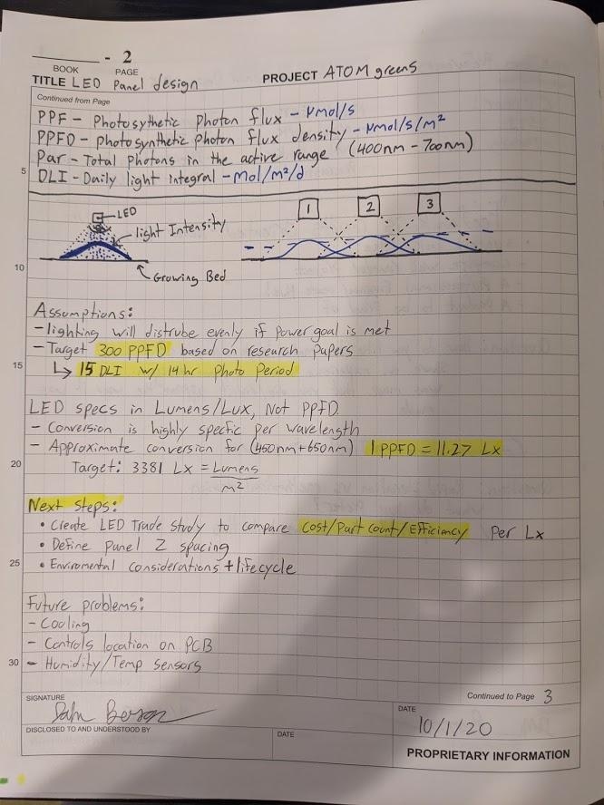
10/01/20
John Berger

Slide 14
10/01/20
Thuya Sathiamurthi
Accomplished this week: Picked seed nomintaion Research on germination Formatting SRD Assigned/filled out SRD things | Potential pitfalls Bad formatting for SRD Electrical portion of SRD is not complete
To be accomplished in next 2 weeks: SRD Powerpoint Research more about the seed nomination profiles for light, water, nutrients, etc | Help needed Electrical SRD

Slide 15
10/8/20
Max Merritt
Accomplished this week: Climate Control Research Preliminary structure sketches Preliminary growing area calculation | Potential pitfalls High humidity cooling Cost
To be accomplished in next 7 days: SRD Slides Structure design Climate control decisions (LED heating vs heater | Help needed
Status report:
Accomplishments:
Climate control Ideation, swamp cooler research
Structure Ideation

Slide 16
10/8/20
John Berger
Accomplished this week: Created LED Matrix (Not Filled) Researched Commercial Nutrient Dispensing Hand sketches of possible Nutrient dispensing Systems Asked Emily about PH Stuff (Haven't read response) | Potential pitfalls
To be accomplished in next 7 days: SRD Slides LED SLD Nutrient/PH SLD LED+ Nutrient Trade Studies Sensor research | Help needed Top level SLD ( I will post today)
Status report:
Liquid nutrient selected + Dispensing system Trade study

Slide 17
10/08/20
Conor Vasiliadis
Accomplished this week: Concluded NFT as hydroponic method Found square inches needed per cup Basic design for NFT UV Lighting for Disease Prevention (Pastuerization very expensive) | Potential pitfalls Beets reportedly very hard to grow Are we able to pick seed density/ grow mat sizes?
To be accomplished in next 7 days: Disease Prevention Layout Slides | Help needed

Slide 18
10/08/20
Thuya
Accomplished this week: Climate control ideation Air flow ideation Watering system (nutrient solution) ideation Looked at a couple LEDS’s | Potential pitfalls Confused about how the product is supposed to look?
To be accomplished in next 2 weeks: SRD presentation | Help needed

